Slide 1

Exploratory Data Analysis on Heart Disease Dataset
This presentation will explore key insights and patterns within a heart disease dataset, uncovering factors that influence the development and prevalence of this critical health condition.
Made By- Vaibhav Singh
C.S.I.T.
Roll No.- 2300290110201
Github Link- https://github.com/Vaibhavsingh167/E.D.A.-Heart-Disease

Slide 2

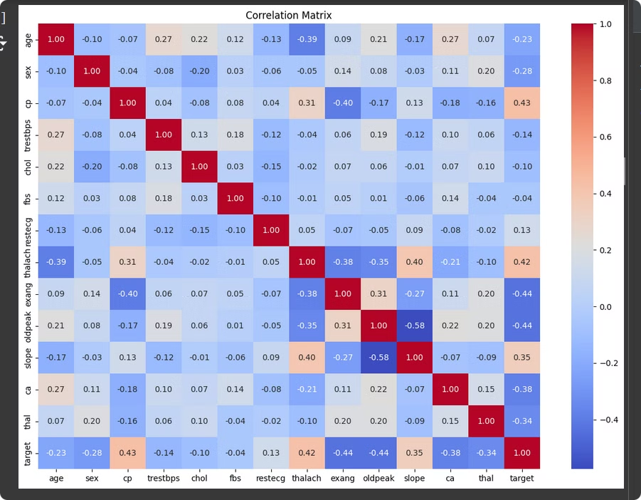
Introduction to Heart Disease and Exploratory Data Analysis
1
Understanding Heart Disease
2
Exploratory Data Analysis
Heart disease is a leading cause of mortality worldwide, impacting individuals of all ages and backgrounds.
EDA helps uncover hidden patterns, identify key risk factors, and inform prevention and treatment strategies.
3
Leveraging Data Insights
By analyzing this heart disease dataset, we can gain valuable insights to improve patient outcomes.

Slide 3
Understanding the Heart Disease Dataset
Data Overview
Key Variables
Data Quality
The dataset includes information on patient demographics, medical history, and diagnostic test results.
Key factors include age, sex, cholesterol levels, blood pressure, and presence of heart disease.
The dataset has been carefully curated to ensure accuracy and completeness for reliable analysis.

Slide 4

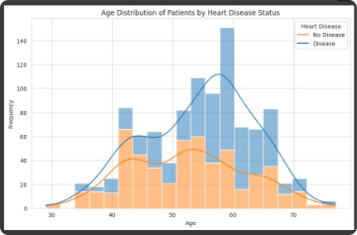
Visualizing the Age Distribution of Patients
Young Patients
Elderly Patients
The dataset includes a significant number of heart disease cases among younger individuals, emphasizing the importance of early prevention.
The incidence of heart disease increases sharply in older age groups, reinforcing the need for specialized geriatric care.
1
2
3
Middle-aged Patients
The majority of heart disease cases occur in middle-aged adults, highlighting the need for targeted interventions in this demographic.

Slide 5

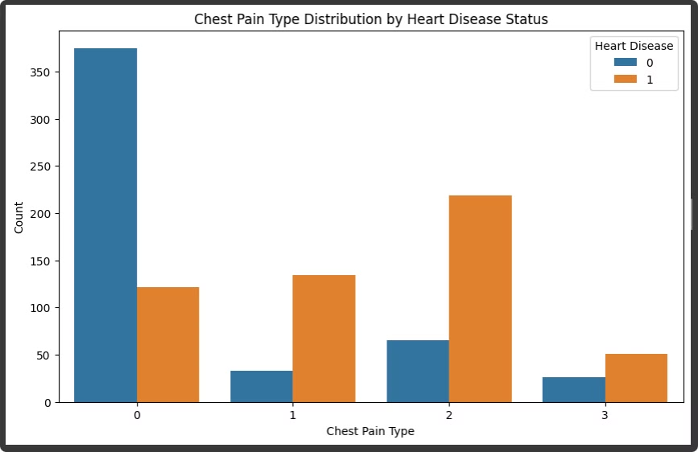
Analyze chest pain types with respect to heart disease
Overview of Chest Pain Types Chest pain, categorized as typical angina, atypical angina, non-anginal pain, and asymptomatic, helps indicate heart disease likelihood, with each type offering diagnostic insights.
Distribution of Chest Pain Types Typical angina is more frequent in heart disease patients, while asymptomatic cases are common in non-disease individuals, aiding in identifying at-risk patients.
Insights from Visualization Visualizing chest pain types reveals typical angina's strong link to heart disease, while atypical and non-anginal pain occur in both disease and non-disease groups.
Diagnostic Value Chest pain types, especially typical angina, provide valuable risk indicators, helping prioritize patients for heart disease testing and guiding broader assessments when necessary.

Slide 6

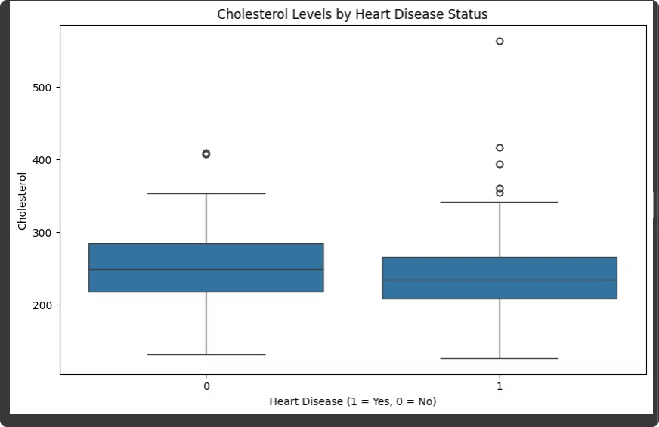



Examining the Impact of Cholesterol Levels on Heart Disease
Elevated Cholesterol
The data demonstrates a strong positive correlation between high cholesterol levels and an increased likelihood of heart disease.
Optimal Cholesterol
Maintaining cholesterol within the recommended range is crucial for heart health, as shown by the significantly lower disease rates.
Targeted Interventions
These insights can guide healthcare providers in developing personalized cholesterol management strategies to reduce heart disease risk.

Slide 7





Investigating the Role of Physical Activity in Heart Health
Cardiovascular Fitness
Muscle Strength
Stress Management
Healthy Lifestyle
Regular physical activity strengthens the heart muscle and improves overall cardiovascular function.
Resistance training helps maintain muscle mass and bone density, which are crucial for heart health.
Exercise can effectively reduce stress levels, a known risk factor for the development of heart disease.
Physical activity often goes hand-in-hand with a balanced diet, further enhancing heart-protective benefits.

Slide 8

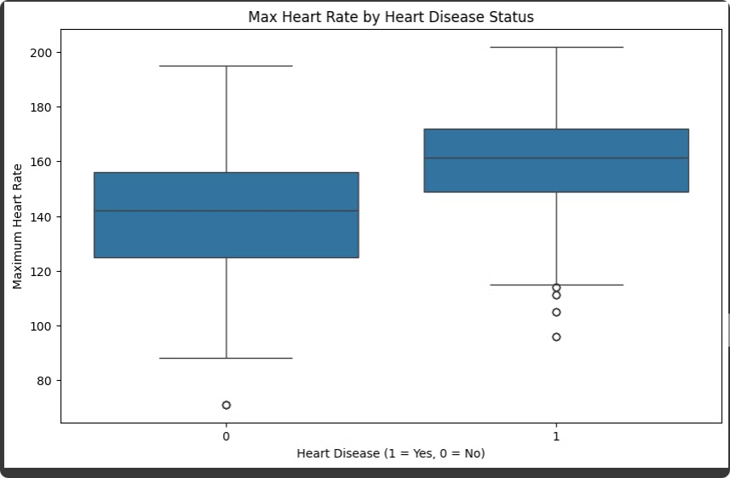
Comparing Risk Factors Between Patients with and without Heart Disease
Risk Factor
Heart Disease Patients
Non-Heart Disease Patients
Age
Higher average age
Lower average age
Smoking Status
Higher rate of smoking
Lower rate of smoking
Cholesterol Levels
Elevated cholesterol levels
Optimal cholesterol levels
Physical Activity
Lower levels of physical activity
Higher levels of physical activity

Slide 9
Identifying Patterns and Insights through Interactive Dashboards
Data Exploration
Visualization Flexibility
Informed Decision Making
Interactive dashboards allow users to easily explore the dataset, filter by various criteria, and uncover hidden trends.
These tools provide a wide range of visualization options to present data in the most insightful and compelling way.
The insights gained from these dashboards can inform healthcare policies, treatment strategies, and prevention programs.

Slide 10

Concluding Remarks and Key Takeaways
1
Comprehensive Analysis
2
Targeted Interventions
3
Ongoing Research
This exploratory data analysis has uncovered significant insights into the factors influencing heart disease development.
The findings can guide the implementation of tailored prevention and treatment strategies to improve patient outcomes.
Continued exploration and analysis of heart disease data will be crucial for advancing our understanding and addressing this critical public health issue.

